Slide 1
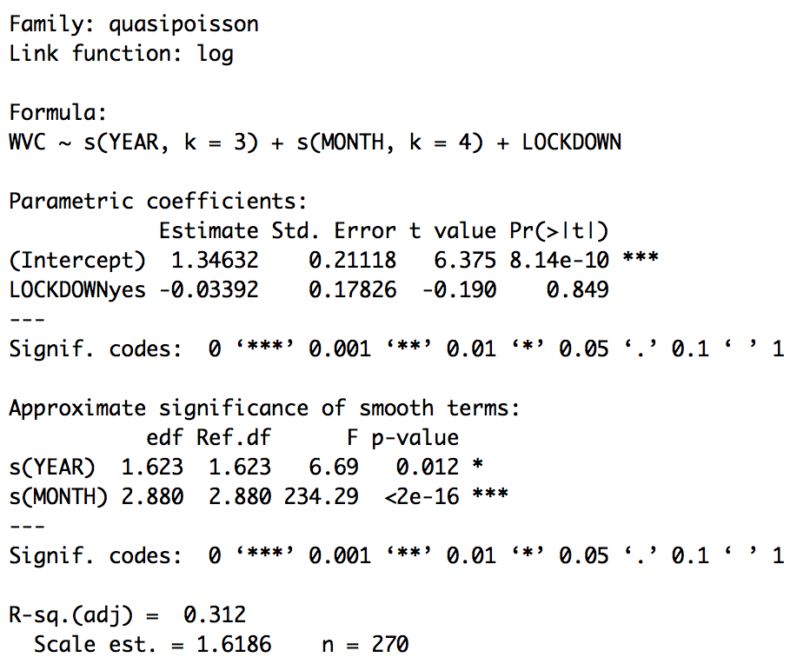
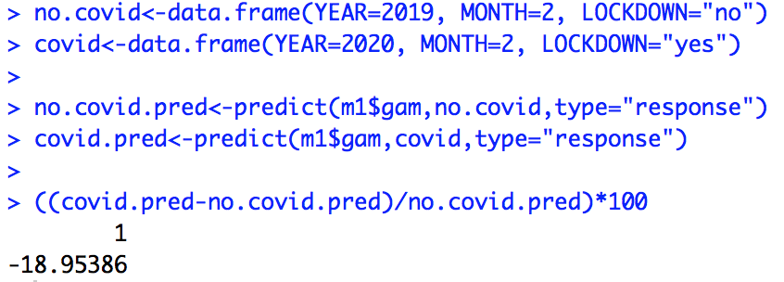
I used a general additive mixed model where Year and Month were included and fitted as a spline function. Highway was included as a random effect. The lockdown period was Feb. and Mar. of 2020.
We have a 19% drop in total wildlife kills in Feb of the lockdown versus the same month in 2019.

Slide 2
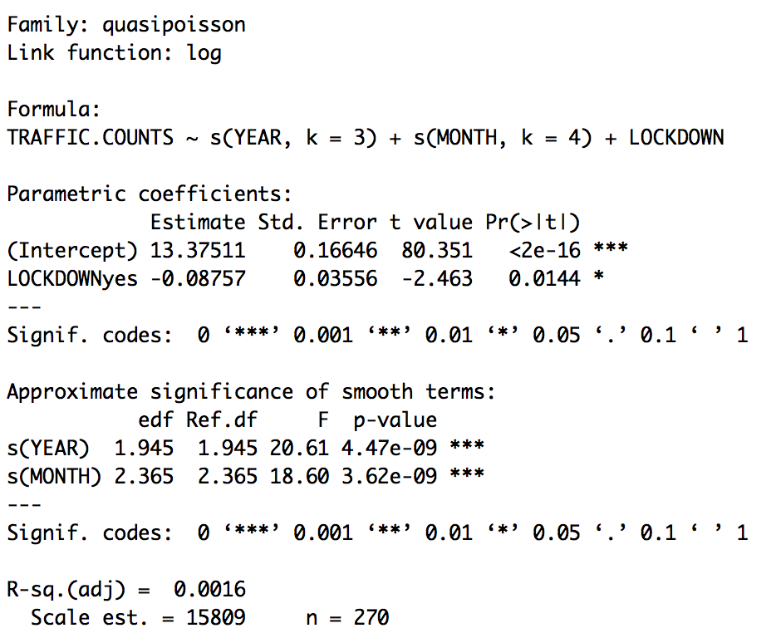
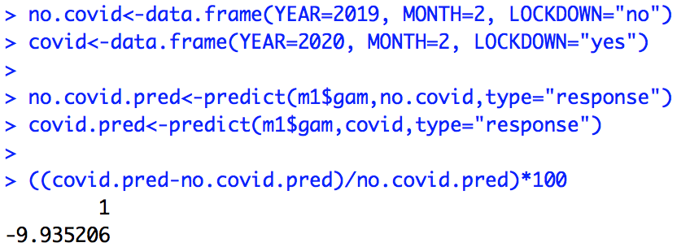
I used a general additive mixed model where Year and Month were included and fitted as a spline function. Highway was included as a random effect. The lockdown period was Feb. and Mar. of 2020.
We have a 10% drop in traffic in Feb of the lockdown versus the same month in 2019.

